Slide 1
Visualizing and Reasoning about Presentable Digital Forensic Evidence with Knowledge Graphs
Weifeng Xu, University of Baltimore
Dianxiang Xu, University of Missouri-Kansas City

Slide 2
Overview
What is digital forensics?
The challenges of presenting digital evidence in the courtroom
Evidence Presentable Problem
Digital Forensic Knowledge Graph (DFKG)
Approach to address Evidence Presentable Problem
Case study
Presenting and reasoning evidence using DFKG
Benefits of DFKG

Slide 3
What is digital forensics?
Digital forensics is the process of examining and interpreting data from digital devices in order to find out what happened.
identification, collection, examination, and analysis of data while preserving the integrity of the information and maintaining a strict chain of custody for the data
The importance of digital forensic evidence
evidence is the key to proving someone is guilty or innocent of the actions they have been charged
Testifying in court as an expert
digital forensic professionals need to present and interpret evidence to various audiences

Slide 4
"The challenges of presenting & interpreting digital evidence in the courtroom"
“It is Friday afternoon in week three of a trial. The jury has returned from lunch, the well-presented computer forensic examiner, though very expert and professional, commences their verbal evidence of the facts and their opinions of what occurred. The jury looks at the books containing the extracted data, emails, log files, or other data.
…
If half of the jury is still listening after five minutes, it would be considered good going; if two of them understand what is being said, this would be an amazing achievement.”
Watt, Allan --- "The challenges of interpreting digital evidence in the courtroom" [2017] Precedent AULA 24; (2017) 139 Precedent 43
Notes:
‘Computer forensics’ refers to the collection, preservation, analysis and presentation of computer-based evidence. In litigation, computer forensics often requires expert testimony.

Slide 5
Evidence Presentable Problems
Computer forensic examiners vs. Juries vs. judgers: Present and interpret evidence to various audiences are hard
Opinions: “with the exception of nuclear DNA analysis…no forensic method has been rigorously shown to have the capacity to consistently, and with a high degree of certainty, demonstrate a connection between evidence and a specific individual or source”
Strengthening Forensic Science in the United States: A Path Forward, called by the National Research Council (NRC)

Slide 6
Approach: Presentable DIgital Forensic Evidence (PreDIE) based on Knowledge Graph
Representing digital forensic evidence in Digital Forensic Knowledge Graph (DFKG)
It puts evidence information in context via linking and the semantic metadata of evidence as well as describes how digital examiners interact with evidence
Different than Web Ontology Language: describing and exchanging static metadata of entities
DFKG supports criteria of PreDIE
Authenticity: A piece of digital forensic evidence is proven to be genuine and not a forgery.
Integrity: A piece of digital forensic evidence should not have been tampered.
Validity: The validity of evidence means that a tool used in forensic examination meets standards.
Credibility: The credibility of evidence demonstrates a forensic examiner who will be responsible for the discovery or interpretation of artifacts
Relevance: Evidence is relevant if it has any tendency to make a fact more or less probable than it would be without the evidence and the fact is of consequence in determining the action

Slide 7
Digital Forensic Knowledge Graph (DFKG)
Cyber Case Descriptive Objects (CCDO),
Cyber Forensic Observable Objects (CDOO)
Cyber Forensic Domain Objects (CFDO).

Slide 8
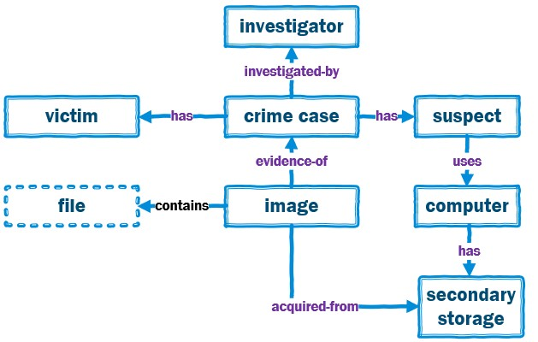

Cyber Case Descriptive Objects
Capture a criminal case's background information
suspects, victims, investigators, and seized disk images.
Answer questions
What is the nature of a cybercrime?
Who are the suspects?
who are victims?
Who is assigned to the case?
Where are these raw images acquired from?

Slide 9
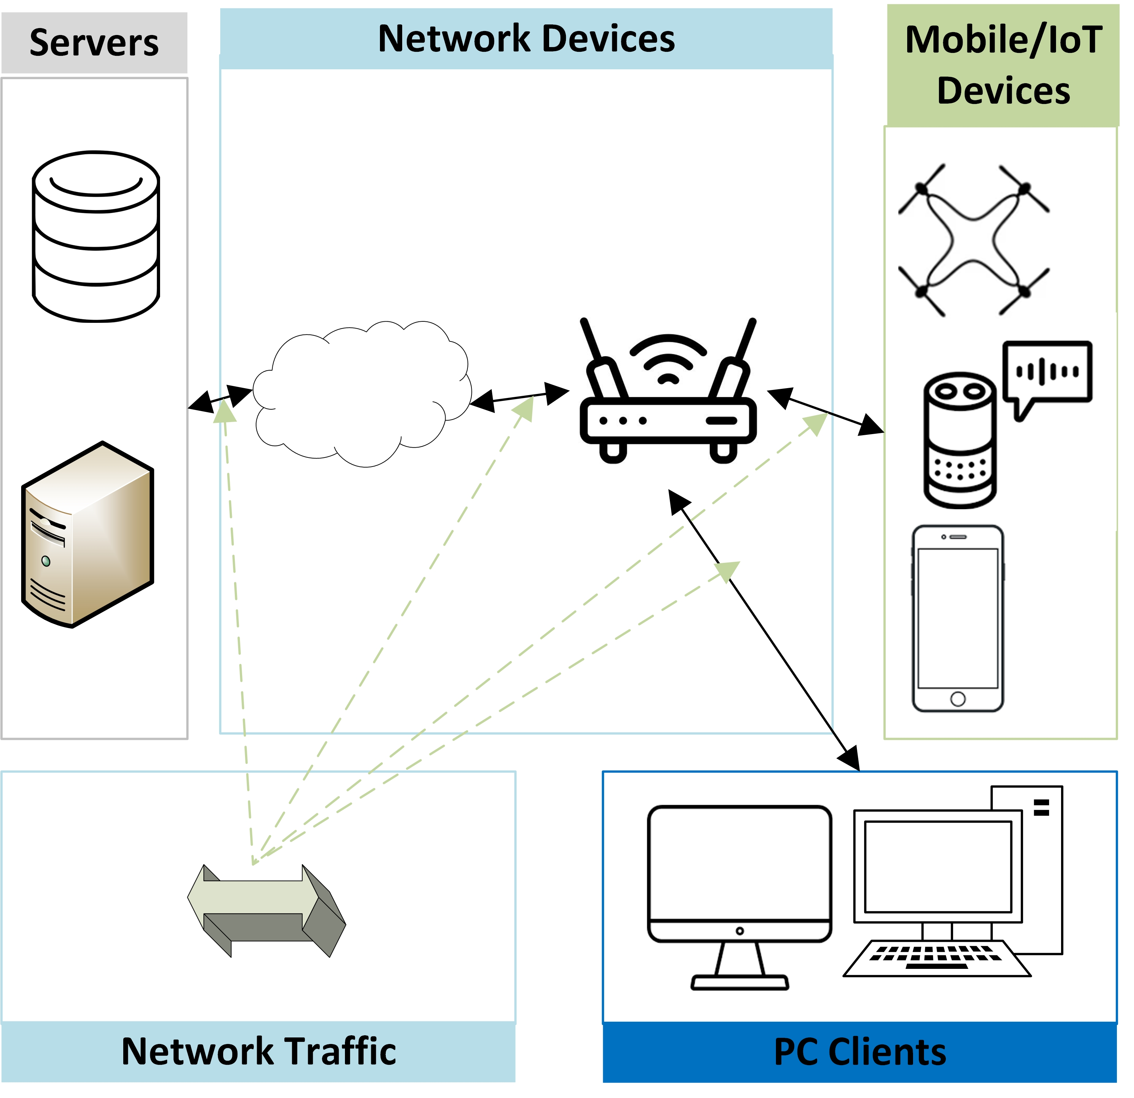
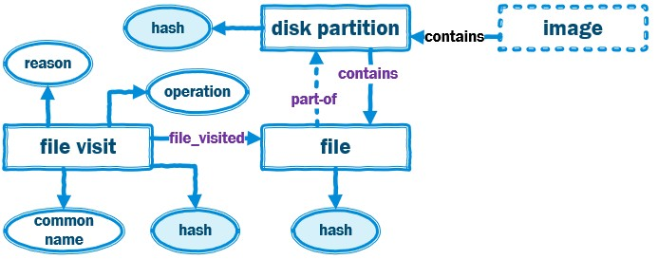

Cyber Forensic Observable Objects
The smallest identifiable and comprehensible artifacts generated from IT infrastructures and devices using the infrastructures.
Disk Partition Object
Plug and Play (PnP) Event Object
Windows Event Object
Webpage Object
Webpage Visit Object
Cloud Storage Object
File Visit Object

Slide 10
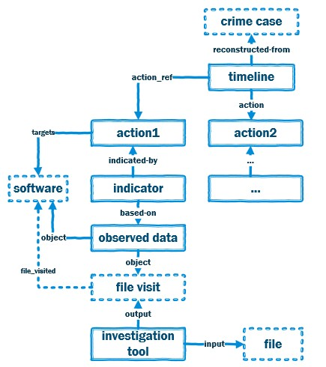




Cyber Forensic Domain Objects
Focus on investigation procedures and specify how criminal activities are reconstructed, what evidence is associated with these activities, and how evidence is observed and identified
Timeline Object: It provides a chronological-based reporting format to describe how reconstructed criminal activities are organized.
Action Object: One cybercriminal activity performed by threat actors.
Investigation Tool Object: Refers to as software or a hardware tool that is used by investigators to perform digital forensic investigations on artifacts

Slide 11

Case study
Dr. Golden G. Richard III, and was originally used in the Digital Forensic Research Workshop 2005 RODEO Challenge
The city of New Orleans passed a law in 2004 making possession of nine or more unique rhinoceros images a serious crime. The network administrator at the University of New Orleans recently alerted police when his instance of RHINOVORE flagged illegal rhino traffic.
Evidence in the case includes (1) Three network traces (log files) and (2) a USB key seized from one of the University’s labs (DD image).
Investigation process
Notes:
https://github.com/frankwxu/digital-forensics-lab

Slide 12
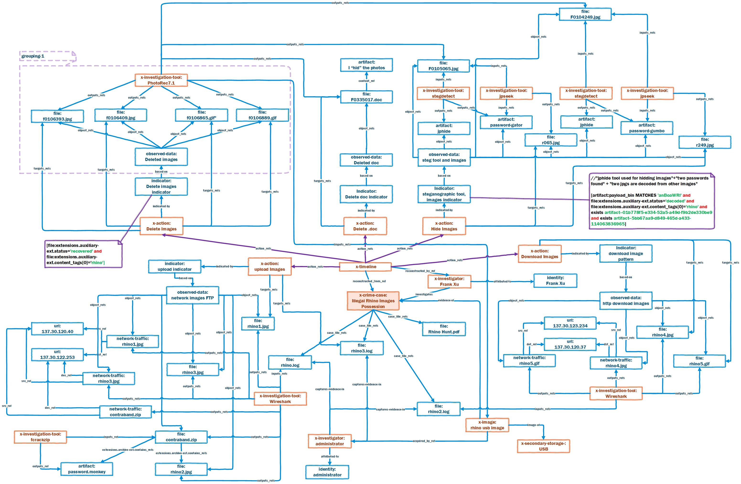

Slide 13

DFKG supports reasoning: What evidence showed a suspect deleted an illegal picture?

Slide 14
Benefits of DFKG
Representing comprehensive intelligence of criminal cases.
Demonstrating that the acceptance of evidence specified in DFKG meets the PreDIE criteria.
Identifying PreDIE criteria for cross-jurisdictional acceptance of digital evidence.
Using as a basis for AI-enabled evidence analysis, such as evidence discovery and evidence validation

Slide 15


